Slide 1
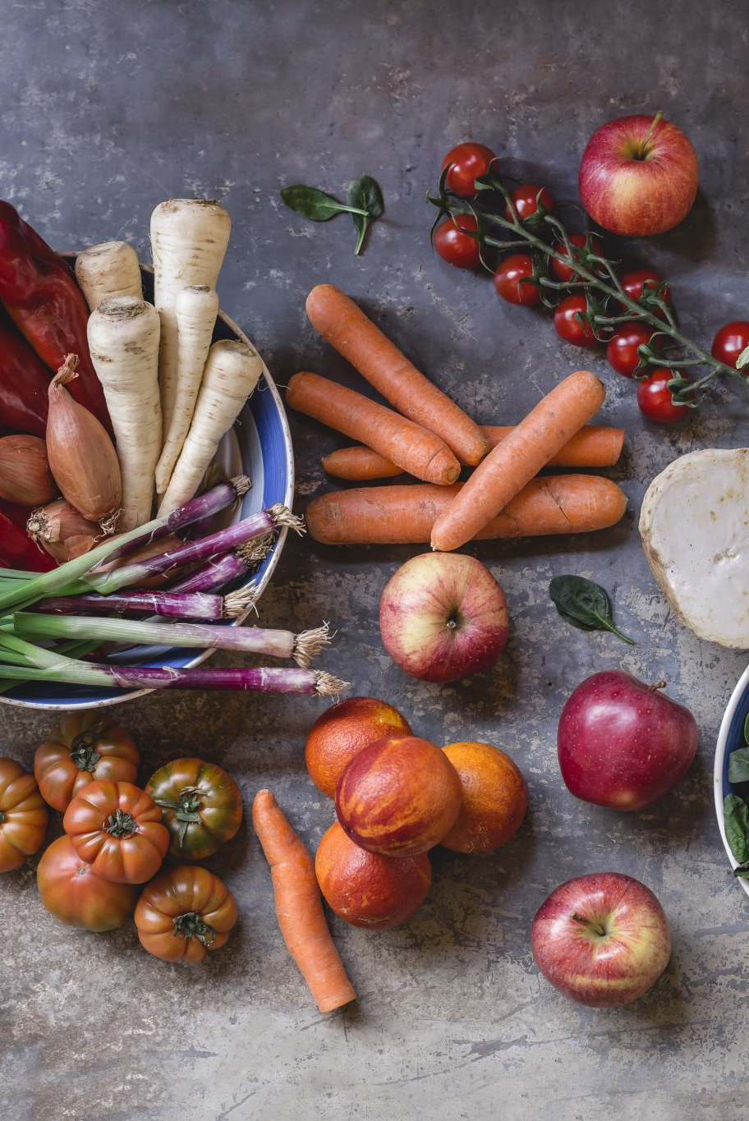
How people with a history with disordered eating think about environmentally sustainable eating
Julia Danielsson

Slide 2
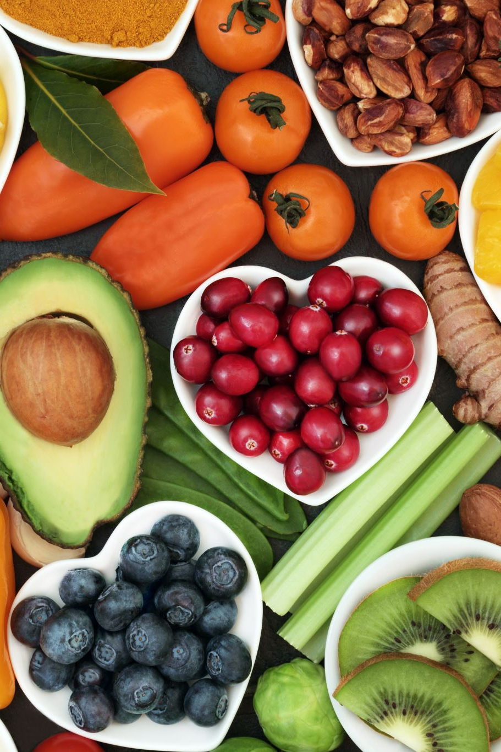

Background
Possible association vegetarianism/veganism and disordered eating (Sergentanis et al., 2020)
Differences between different motivations for vegetarianism

Slide 3
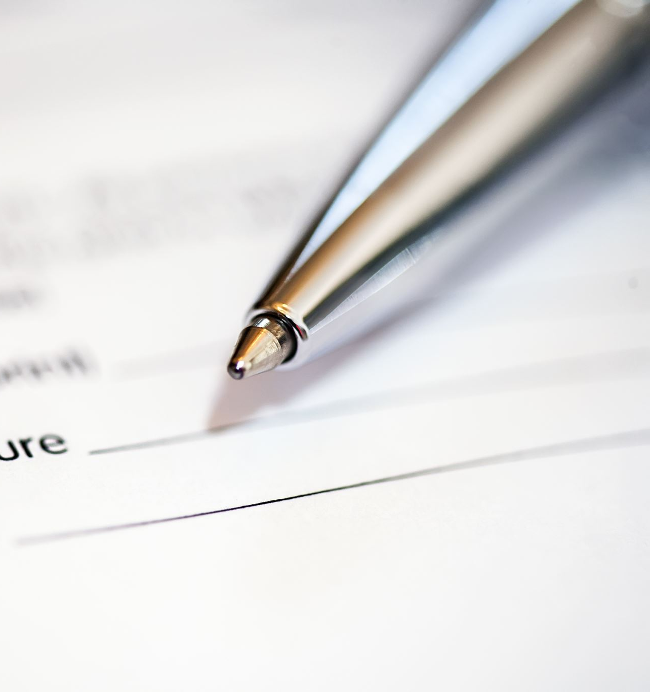
Method
Explorative qualitative study
12 interviews
Reflexive thematic analysis
Critical realism

Slide 4
Disordered eating as an additional barrier to environmental sustainability
I've tried to like cut down meat consumption in the past, because I know how bad it is for the environment. But it kind of turns into that control thing with disordered eating, it’s like, if I can control how to do this, I can control eating this, I can control eating that, and it kind of like leads to a bit of a slippery slope. So it's kind of why I stopped.
-Iris
I feel that if I wanted to help, it would have to come in a different way, and it would have to come in a way in which, you know, it's already made easy for me. Like I don't have to do the effort. Like, I feel that I would have to go into a store and then kind of see the alternative and take it, you know, because I feel that if I started to like, really, really, really be concerned about environmental eating, then I would go back to this way of being that it's like I am living to eat instead of eating to live. So even when it comes to, like, a very good reason to be concerned about something, I feel like the effort would have to come outside of me so that I would have to put the minimum effort possible to kind of like reach that sustainability basically. -Mia

Slide 5

Sustainable eating as a method of control
Sustainable eating as a cover
Sustainable eating as a part of recovery

Slide 6
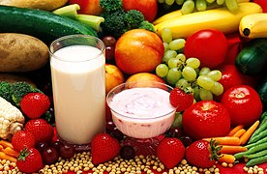
Sustainable eating as a cover
…when I was like at my deepest points in my eating disorder, I would look for excuses to explain why I ate certain things or didn't eat certain things. […] I used the guise of being like ‘ohh it's better for the environment, you know, I really care about that, like it's so bad with the meat industry’. Which is, of course, something that I knew about, and I was concerned about these things. But at the same time, it wasn't like the main reason, […] because it's a way of having control, that's also sort of easier to hide it or explain it, or even if you maybe don't even wanna acknowledge that you have an issue with food…
-Natalie

Slide 7
Sustainable eating as a part of recovery
…I think nature made it very efficient and in winter you need more comforting food then there's potatoes that come out the ground. So it's it is, I think in the eating moments I think it's also good for your body because it responds to your natural biological needs. […] Yeah, I try eating like good vegetables so that when I eat, I don't have the sense of guilt of ‘ohh I'm going to get heavier’ or stuff like that. Like, okay this is good for my body because it's sustainable. It's, it's a good food. It comes from the earth […] For me, sustainable is quite a grounding thing in the recovery. -Helen

Slide 8
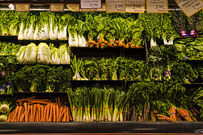
We do the best we can with what we have
I think [eating]'s got to be balanced. It's got to kind of honour your own personal preferences. And to me, food is more than just like energy and energy out. You've got to kind of take into account like sustainability, but also like the social component of eating and food and maintaining relationships, and something that by eating in a way that honours all of those things, I think is like sustainable to me… -Sophie
Making people feel guilty about food in any way can very quickly have very negative repercussions, even if you're not doing it intentionally. […] certain times it will come from a place with a bit of lack of knowledge about other people's experiences and how big of an impact food has on people's lives, […] for some people it can be a case of like, ‘well, why isn't everyone doing this? I do it. I enjoy it. I find it easy’ and sometimes you'll see conversations like that and it's just, for me it's just a bit frustrating and can be a bit upsetting if it's like really aggressive.
-Lily

Slide 9
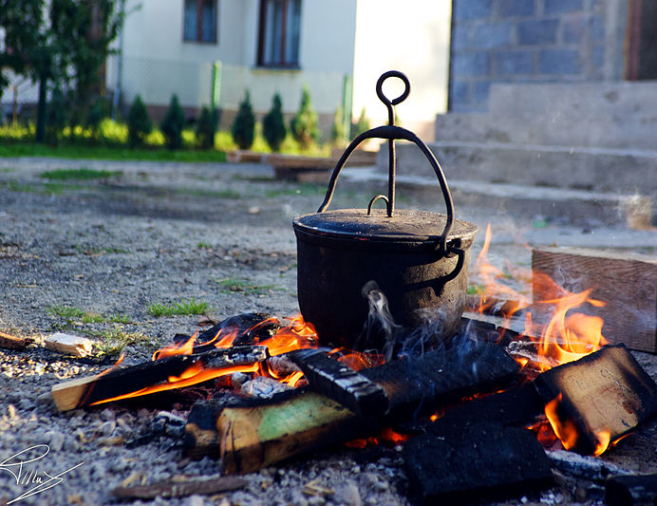
Discussion and implications
Differences within disordered eating → differences in interactions with sustainable eating
Nuance and practicality in conversations
Mainly women interview: men, masculinity, sustainability, and meat?

